Slide 1

Automatic Fruit Ripeness Detection and Quality Grading Using Image Analysis
DSA0216-Computer Vision With Open CV For Modern AI
PRESENTED BY:
S. Manigandan(192424057)
R. Jayanth (192424286)
GUIDE:
DR. S . Senthil vadivu DR. T . Kumaragurubaran
PROFESSOR.

Slide 2


ABSTRACT
The system uses computer vision techniques to automatically detect fruit ripeness and assess quality from captured images.
Images are preprocessed and converted into HSV color space for accurate color-based segmentation and feature extraction.
Features such as color, texture, and shape are analyzed to classify fruits into unripe, ripe, and overripe stages.
A grading algorithm categorizes fruits into quality levels (Grade A, B, C) based on size and surface defects.
The automated approach reduces manual effort, increases speed, and ensures consistent and reliable sorting for agricultural and industrial applications.

Slide 3
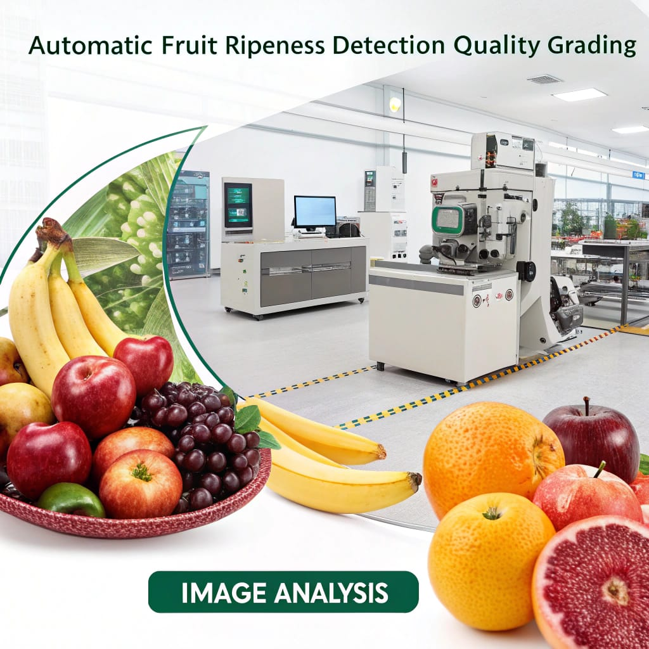
INTRODUCTION
Automated fruit grading ensures consistent quality and reduces dependency on subjective manual inspection.
Image analysis enables fast, accurate, and non-destructive evaluation of fruit ripeness levels.
Color, texture, and shape features extracted from images act as strong indicators of ripeness and external quality.
Machine learning methods improve decision-making by learning patterns from labeled fruit datasets.

Slide 4
OBJECTIVES
Develop an automated system to detect the ripeness level of fruits using image analysis techniques.
Classify fruits into different quality grades based on color, texture, and size features extracted from images.
Reduce human error and labor costs in fruit sorting and quality assessment processes.
Implement real-time detection and grading to facilitate faster processing in agricultural and supply chain systems.
Enhance post-harvest management by providing accurate and consistent ripeness and quality information for fruits.

Slide 5
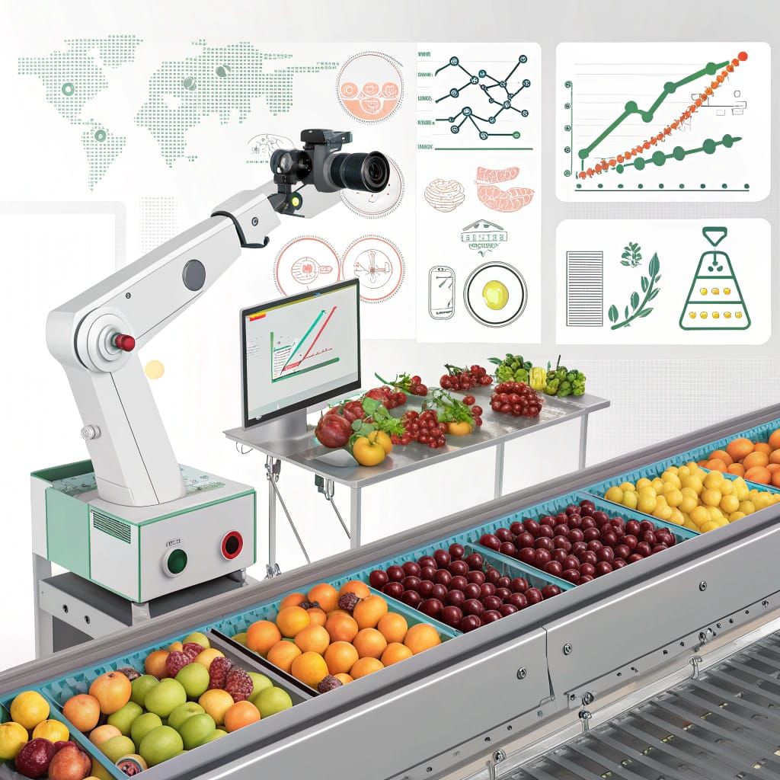
METHODOLOGY
Capture fruit images under controlled lighting to reduce shadows and reflections.
Preprocess images using resizing, filtering, and background removal for clean input data.
Extract essential color, shape, and texture features (HSV, GLCM, contour features).
Evaluate system performance using IoU, accuracy, confusion matrix, and feature visualization.

Slide 6
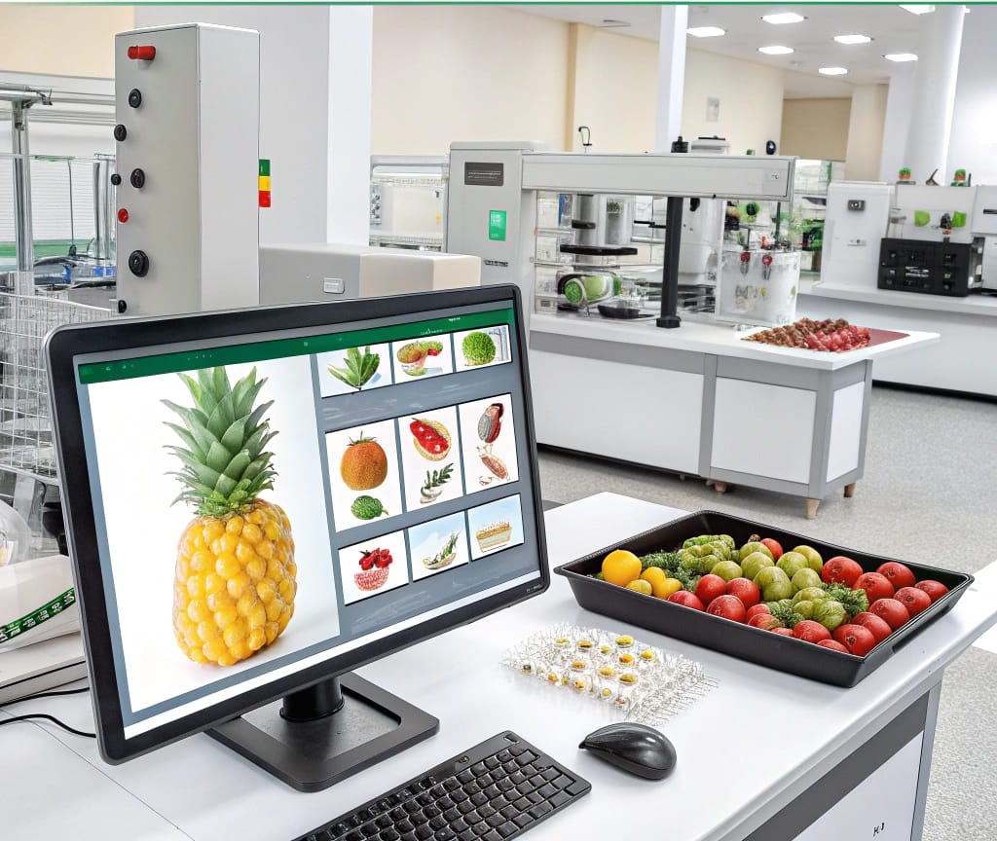
MODULE 1-Fruit Image Preprocessing and Region Segmentation
Apply HSV color masking to isolate fruit pixels from the background.
Use GrabCut segmentation for refined foreground extraction.
Perform morphological smoothing (erosion, dilation, closing) to remove noise.
Extract dominant fruit contour using contour detection methods.
Validate segmentation using IoU, histogram accuracy, region purity, and shape consistency.

Slide 7
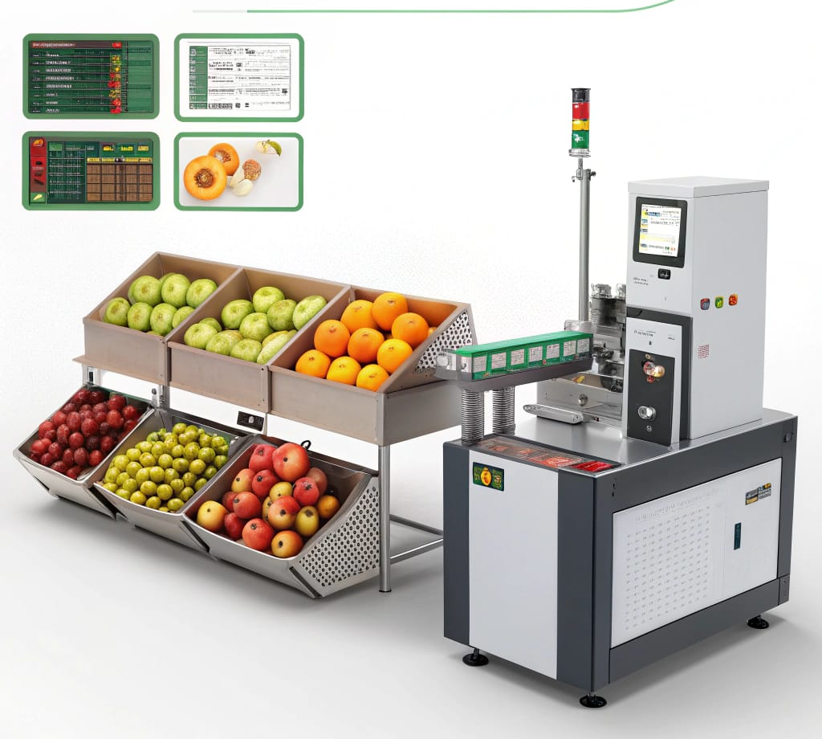
MODULE 2 - Ripeness Detection and Quality Classification
Extract HSV color intensity features to identify ripeness changes.
Calculate texture features (entropy, contrast, GLCM metrics) for defect evaluation.
Train KNN/SVM classifiers for multi-stage ripeness and quality grading.
Apply threshold-based rules for simple color/defect-based classification.
Assess classification using accuracy, confusion matrix, and feature visualization.

Slide 8
LITERATURE REVIEW
Author / Year | Method / Technique | Fruit Type | Key Features Used | Accuracy / Outcome | Remarks
Zhang et al., 2018 | Image processing (RGB & HSV analysis) | Apple | Color, Shape | ~85% | Works well under controlled lighting
Rahman et al., 2020 | Convolutional Neural Networks (CNN) | Banana | Color, Texture, Shape | >90% | Automated feature extraction, high accuracy
Li & Sun, 2017 | Support Vector Machine (SVM) | Tomato | Color Histogram, Shape, Texture | 87% | Needs manual feature extraction, good for small datasets
Wu et al., 2021 | Hyperspectral Imaging | Strawberry | Spectral Features (Sugar, Firmness) | 95% | Very high accuracy, but requires expensive hardware

Slide 9
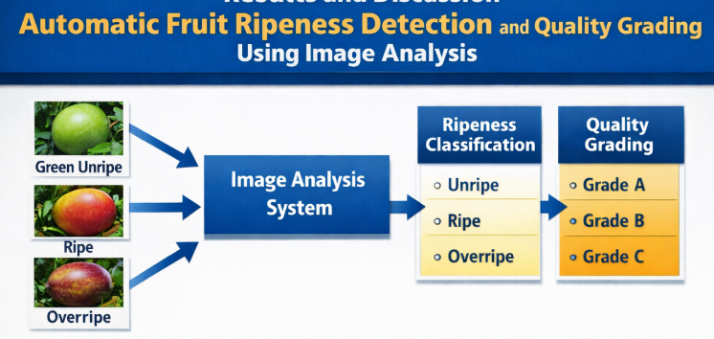
RESULTS AND DISCUSSION
High Ripeness Classification Accuracy – The system successfully identified unripe, ripe, and overripe fruit.
Effective Quality Grading – Fruits were automatically categorized into Grade A, B, and C based on size, shape, and surface defects.
Reduced Manual Effort and Time – Automated image processing significantly decreased human intervention.
Robust Performance Under Different Conditions – The model maintained stable performance under varying lighting and background conditions, making it suitable for real-time industrial applications.

Slide 10
CONCLUSION
The system accurately detects fruit ripeness and quality using image processing.
Color and texture features help classify fruits more reliably than manual inspection.
Automation improves speed, consistency, and reduces human error.
The model is flexible and can work with different fruit types.
The project supports smarter, technology-driven agricultural practices.
The system helps reduce post-harvest losses by identifying overripe or defective fruits early.
It provides a strong foundation for developing advanced smart-farming and automated grading systems.

Slide 11
REFERENCES
Morshed, M. S., Ahmed, S., Ahmed, T., Islam, M. U., & Rahman, A. B. M. A. — Fruit Quality Assessment with Densely Connected Convolutional Neural Network (Dense Net). Ar Xiv preprint, 2022.
Liu, Y., Li, M., & Ma, Q. — Efficient Apple Maturity and Damage Assessment: A Lightweight Detection Model with GAN and Attention Mechanism. Ar Xiv preprint, 2023
Oli sah, C. C., Trewhella, B., Li, B., Smith, M. L., Winstone, B., Whitfield, E. C., … Fernández, F. — CNN Ensemble Learning for Hyperspectral Imaging-based Blackberry Fruit Ripeness Detection in Uncontrolled Farm Environment. ar Xiv preprint, 2024.
Luo, D., Luo, R., Cheng, J., & Liu, X. — Quality detection and grading of peach fruit based on image processing method and neural networks in agricultural industry. Frontiers in Plant Science, 2024.

Slide 12


